Slide 1
BIMSA Compute Cluster
IT@BIMSA

Slide 2
Introduction
Mid-performance, shared & job-scheduled
For academic and research
6 compute nodes
2 login nodes
2 storage nodes

Slide 3
Hardware - Compute Nodes (6 sets)
CPU | Dual Intel Xeon Gold 6444Y (3.6GHz,16C/32T,45MB Cache)
Memory | 768GB (24 x 32GB RDIMM 4800MT/s)
GPU | Dual NVIDIA L40 GPU PCIe(ECC 48GB GDDR6)
NIC / HBA | Dual 10 SFP28 / Dual 25GbE SFP28
Boot | Dual NVMe M.2 480GB (Configured in Raid-1)
/home | BeeGFS, 100TB Shared

Slide 4
Hardware - Login Nodes (2 sets)
CPU | Dual Intel Xeon Gold 6442Y (2.6GHz,24C/48T,60MB Cache)
Memory | 128GB (4 x 32GB RDIMM 4800MT/s)
NIC / HBA | Dual 10 SFP28 / Dual 25GbE SFP28
Boot | Dual NVMe M.2 480GB (Configured in Raid-1)
/home | BeeGFS, 100TB Shared

Slide 5
Hardware - Storage Server (2 sets)
CPU | Dual Intel Xeon Gold 6442Y (2.6GHz, 24C/48T)
Memory | 128GB (4 x 32GB RDIMM 4800MT/s)
NIC / HBA | Dual 10 SFP28 / Dual 25GbE SFP28
Boot | Dual NVMe M.2 480GB (Configured in Raid-1)

Slide 6
System
Operating System | Ubuntu 22.04 LTS
Shared Storage | BeeGFS mounted at /home throughout the cluster
Central Authentication | OpenLDAP
Job Scheduling | Slurm
Software | Ubuntu Build-Essentials (for source compiling) Anaconda 24.5.0 CUDA 12.4& CUDNN (compute nodes only)

Slide 7
General Usage
Test your program at your own machine
Prepare your compute environment at your home directory
Prepare slurm submission script
Submit your job
Get back execution result stored at your home directory

Slide 8
Demo
BCC Compute Cluster Billing Statement
Payment Scheme 1. BCC is charged according to the following scheme: - CPU CNY ¥0.07 per core per hour - GPU CNY ¥2.00 per card per hour 2. Each user account have 500GB disk space for free. When exceeded, the charging scheme will be CNY ¥1.00 per 500GB per day.

Slide 9
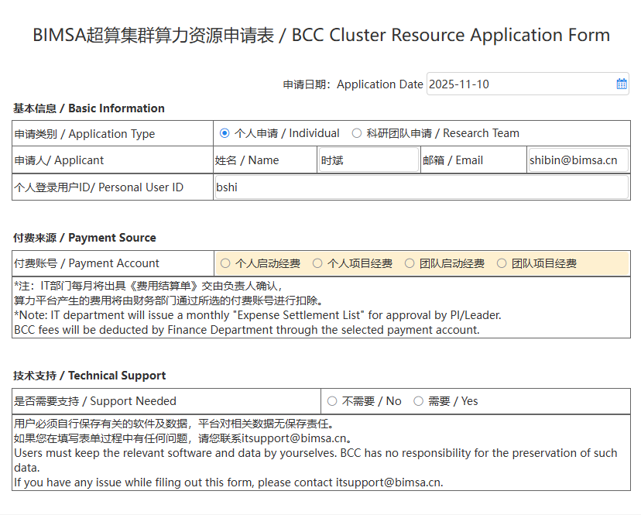
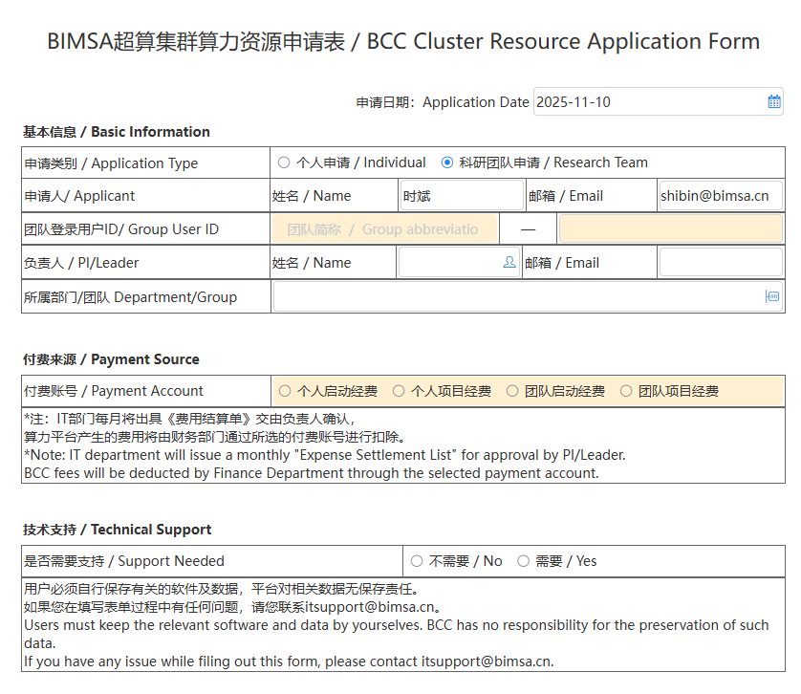
Demo
Fill out the BCC Cluster Resource Application Form in the OA system.
ai4pde
szq
Example: [team abbreviation] ai4pde-szq
For “Individual”, the logged-in user ID will be filled in automatically.
For “Research Team”, enter the team user ID (use lowercase letters).

Slide 10
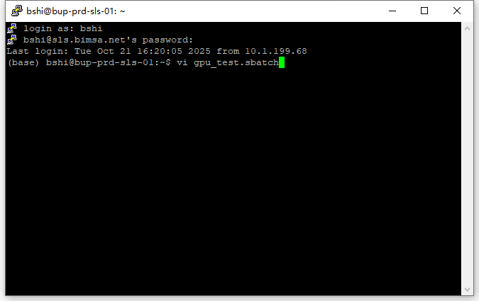
Demo
After the computing resource application is approved, you can log in to the cluster using the information provided in the feedback email.
SSH:sls.bimsa.net:22
#!/bin/bash
#SBATCH --time=00:10:00
#SBATCH --job-name=task_$n
#SBATCH --partition=bcc01
#SBATCH --ntasks=1
#SBATCH --ntasks-per-node=2
#SBATCH --gres=gpu:2
#SBATCH --output=out.%j.log
nvidia-smi --query-gpu=name,memory.total --format=csv
hostname
$sbatch gpu_test.sbatch

Slide 11
Demo
Explanation of parameters in the sbatch script
-t, --time=<time> # Maximum allowed runtime for the job; currently, a single task is allowed up to 30 days;
-J, --job-name=<jobname> # Specify the name of the job；
-p, --partition=<partition> # Submit the job to the corresponding partition; the current BCC partition is bcc01;
-n, --ntasks=<number> # sbatch does not execute the task immediately, it is used to request the necessary resources to run the script;
# By default, a task uses one CPU core, the --cpus-per-task parameter can be used to change this default；
--ntasks-per-node=<ntasks> # Number of tasks per node; the --ntasks parameter takes precedence over this setting;
# If the –ntasks parameter is used, it will specify the maximum number of tasks running per node；
--gres=gpu:2 # Request two GPUs per node;
-o, --output=<filename> # Output file, the output from the job script will be written to this file.

Slide 12
Demo “sinfo”
Check the idle status of the nodes
Display the idle status of all partition nodes in the cluster: “idle” means the node is free, “mix” means some cores on the node are available, and “alloc” means the node is fully occupied.
sinfo
You can use the following command to check the existing partitions, as well as how many CPU cores and how much memory can be requested in each partition.
sinfo -o %P %G %c %m %D %O %t"
%P Partition name; the default partition for jobs is marked with “*”.
%m Memory size per node (in MB).
%c Number of cores per node.
%D Total number of nodes.
%O CPU load.
%t Node status.

Slide 13

Demo “sinfo”
You can see that BCC currently has 5 idle compute nodes.

Slide 14

Demo “sacct & scontrol show job ”
Both sacct and scontrol show job can display information about jobs. scontrol show job provides more detailed information but only for jobs that are still running or have just finished.
# Check detailed information for job 852.
scontrol show job 852
Use sacct to query information about completed jobs, as shown below:
sacct -j 852

Slide 15
Demo “scancel”
Scancel is used to cancel jobs that have been submitted to the queue and is limited to jobs submitted by your own account.
# Cancel the job with ID 852.
scancel 852
Cancel all jobs submitted by your account—use with caution:
scancel -u $USER
Cancel all jobs in PENDING status for your account.
scancel -t PENDING -u $USER

Slide 16
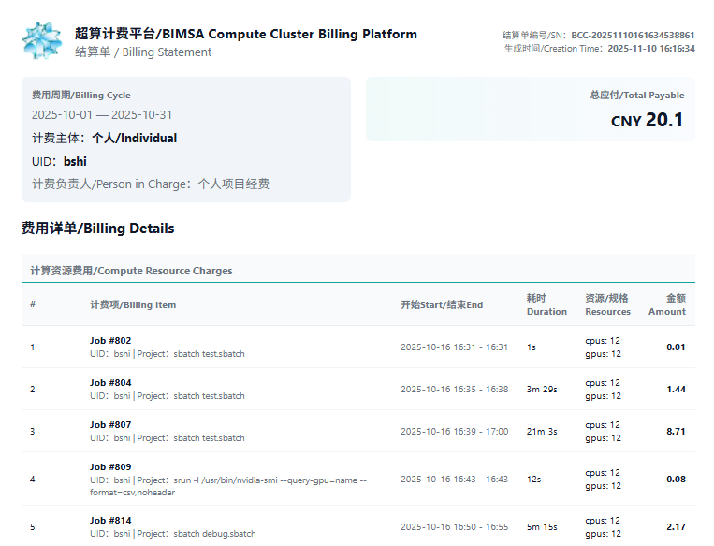
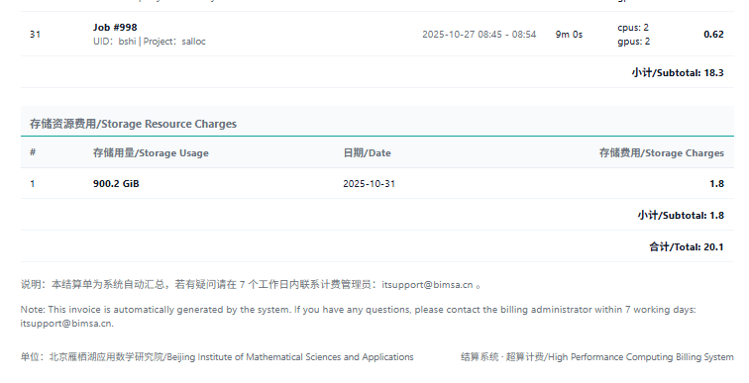
Demo
BCC Compute Cluster Billing Statement
Subtotal of computing costs
Task execution list
Resource usage
Subtotal of storage costs
Each account can use 500 GB of disk space for free.
Any additional usage is charged at 1 RMB per 500 GB per day.

Slide 17
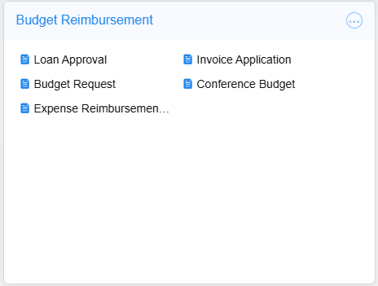
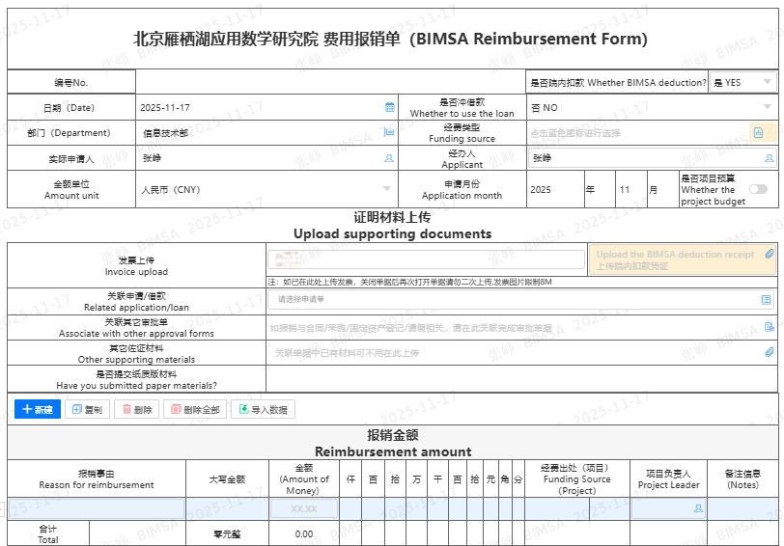
Demo
BCC Compute Cluster Billing Statement
BIMSA deduction “YES”
Whether to use the loan “NO”
Select Funding Source
BCC Reimbursement Form
Upload BCC Billing Platform
Enter reimbursement reason (BCC expenses of November)
Input Billing Platform Amount of Money

Slide 18
DO & DON’T
DOs
Monitor your compute progress via log files at your home directory (you may need to adjust your code)
Responsible for the software you installed at your home directory
DON’Ts
Run your job directly at login nodes
Over-allocate compute resources
Prolonged execution
Coin-mining

Slide 19
General Limitation
No X-Windows apps
No unlicensed software
System limit: 192 Cores, 3TB RAM, 12 GPUs
Currently, the cluster can only be accessed inside BIMSA network
IT does not provide backup service to BCC. Please take care of your code and data.

